Slide 1
WILCOXON TEST
Lab Session

Slide 2
What Should Students do in Wilcoxon Lab Session
Preparation
Complete the Code
Do the task and send the task requirement to the EE-CLASS

Slide 3
A. Preparation
Tools
Installed Matlab
Prepare the data and the files
Download the data in the eeclass system
You must have:
PPT file of Wilcoxon Test Lab session to see the instruction
Word file of Wilcoxon Test Lab session
groupSample1.mat ~ groupSample6.mat (6 groupSample)
Copy the code of Lab Session Word file then save it in the same folder with the data (groupSample1~6.m)
Add the code and data to Matlab path

Slide 4
B. Complete the Code
Perform Wilcoxon Test
Load all mat files (groupSamples)
Perform Wilcoxon signed rank test using small sample size
Perform Wilcoxon signed rank test using large sample size
Load the mat files:
group3 = load(‘groupSample3.mat’)
Small size sample: groupSample3.mat and groupSample4.mat
Large size sample: groupSample5.mat and groupSample6.mat

Slide 5
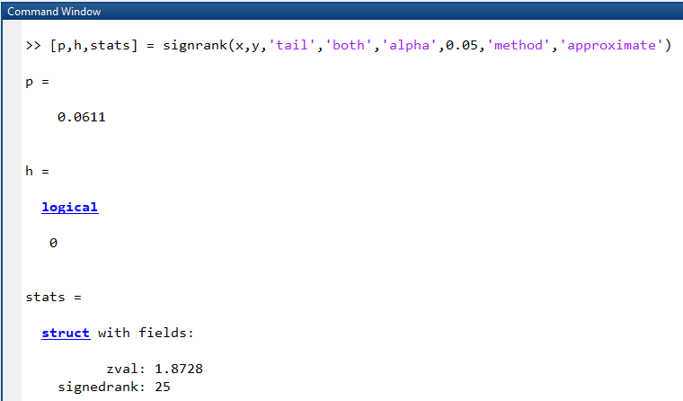
B. Complete the Code
% Wilcoxon Signed Rank Test
% performing Wilcoxon test using approximate method
[p,h,stats] = signrank(group1,group2, 'tail', 'both','alpha',0.05,'method',‘approximate');
% performing Wilcoxon test using exact method
[p,h,stats] = signrank(group1,group2, 'tail', 'both','alpha',0.05,'method','exact');
Perform Wilcoxon signed rank test using small sample size (groupSample3.mat and groupSample4.mat)
Using exact method
Using approximate method
Perform Wilcoxon signed rank test using large sample size (groupSample5.mat and groupSample6.mat)
Using exact method
Using approximate method
P-value
decision

Slide 6
C. Do the task and send the task requirement to the EE-CLASS
Compress(.zip,.rar) the following file with the name of the group (e.g. Group_1.zip)
Code(*.m)
Report(*.doc)
Result of exact and approximate (p-value[p] and decision[h]) from small and large sample size.
Conclusion of result.
Compare the hypothesis result from exact and approximate method from small sample size
Compare the hypothesis result from exact and approximate method from large sample size
Analyze if there is different hypothesis result from different method

